Slide 1
Project Milestone 1 AS-IS Presentation
Centralized Application System:
Common Application
Grad Gurus, Group 1:
Temilade Afolabi
Yanyun Bi
Ashritha Shetthalli
Michael Rogowski
Matthew Valdez

Slide 2
Introduction
a. Identify the Process Under Discussion (i.e. the Process in Scope)
The Common Application (informally known as the Common App) is an undergraduate college admission application that applicants may use to apply to any of more than 700 member colleges and universities. On this system, Students are allowed to apply for multiple colleges simultaneously at once with nominal application charges. The idea behind the Common App is to try and reduce the barriers that students face when applying to college.
But the Common App is limited to Freshman and Transfer students looking for an admission to enroll in a Bachelor’s degree. Moreover, the Common App allows students to self-report standardized test scores, but the vast majority of colleges demand direct reporting of scores through the testing agencies.

Slide 3
Introduction
b. What is the Organizational Context?
Internal Environment:
➤It is managed by the staff of a not-for-profit membership association (The Common Application, Inc.) and governed by a 13-member volunteer Board of Directors drawn from the ranks of college admission deans and secondary school college guidance counselors.
➤The step by step introduction is very clear to help a student apply. The counselor can give some advice according to the student’s practical situation.
➤ Most of the membership colleges are private.
External Environment:
➤The Common App started in 1975, and as of September 2017, 747 colleges accept the Common App. Therefore, the admissions officers who read these applications know the forms inside and out.
➤The Common App is free to use and about 45 percent of the member schools don't charge application fees.
➤The platform is popular, but it isn't the only one for college applications. There are other applying platforms also. Many schools allow students to apply online through their websites.

Slide 4
Introduction
c. Mention Any STEEPLE Factors that are Influential.
Social: Focus is on high school students.
Technological: New Common App for transfer students will be available in early 2018.
Economic: A non-profit organization.
Environmental: It represents almost 700 schools and students don’t need to submit an application separately.
Legal: All information students send is encrypted using TLS.
Ethical: Helpful guidance for students applying to colleges and universities.
d. Who are the Major Stakeholders?
➤Students ➤ Parents ➤Counselors ➤Colleges/Universities

Slide 5
Introduction
e. What are the Inputs that Trigger the Start of the Process and the Outputs that Signal Completion of the Process?
Inputs that Trigger the Start of the Process:
Student visiting the website and applying to school.
Output that Signals Completion of Process:
Common App producing a PDF file including Common Application ID number (CAID).

Slide 6
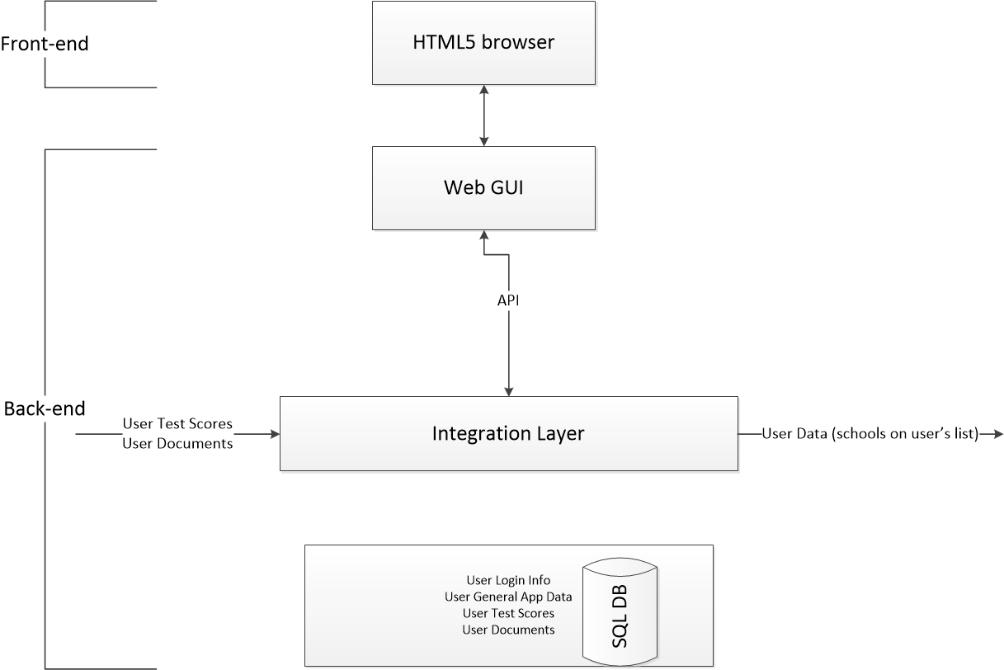
Introduction
f. Provide a High-Level Diagram of the Process

Slide 7
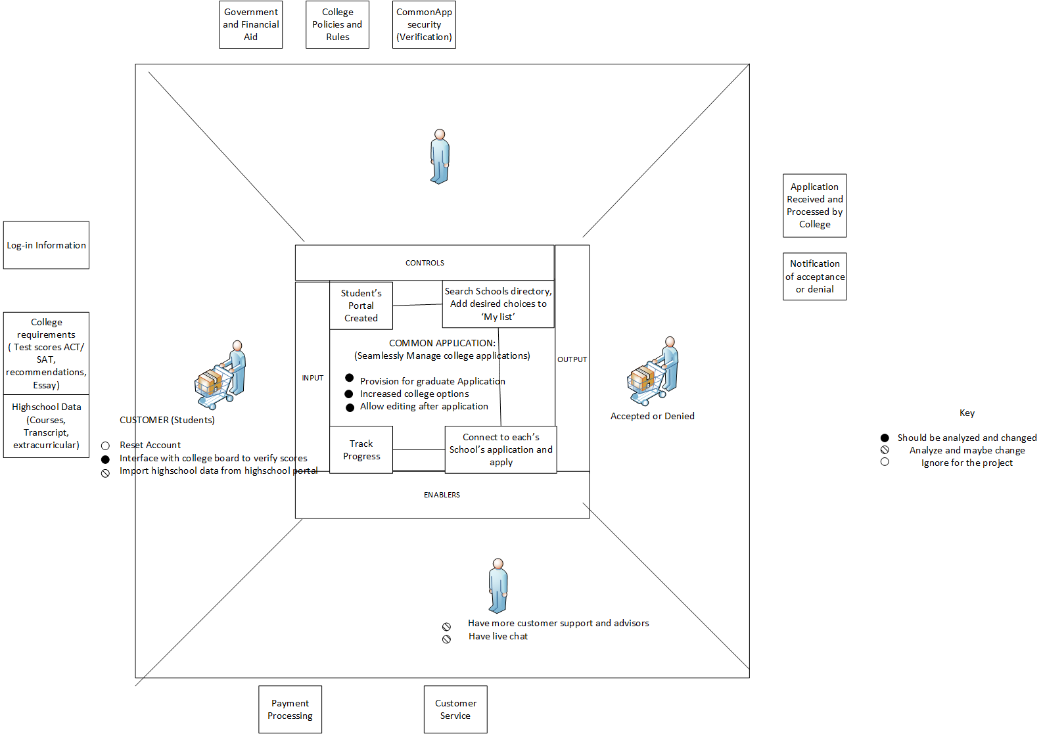
Project Scoping Diagram for Process
Notes:
This is

Slide 8
AS-IS Process
1. Create CommonApp Account.
2. Search CommonApp Directory of 700 schools from 21 countries offering undergraduate courses and add choices to ‘My colleges’ List.
3. CommonApp connects directly to applications page for each school.
4. Requirement Tracker: Understand requirements for each school. Keep track with the tracker worksheet.
5. Gather general Application Information (The part of the application that is basically same for all schools).
6. Commence filling out each application.
7. Download commonApp onTrack Mobile app to track progress, add and invite recommenders, create reminders and tasks.

Slide 9
Work System Snapshot
Customers | Products & Services | Processes and activities
Refers to the people using or products and services of the work system. High School Seniors applying to colleges | All outputs of the commonApp that directly contribute to students being able to achieve seamless application A platform to manage college applications with interface to 700 schools across the globe. Expert Virtual Counselor on all things college. | All steps involved in production of final products and services Creating a personal common app account Adding schools to dashboard Completing applications for different schools Getting expert college selection advice
Participants | Information | Technology
People and machines that perform the work Common app (Platform and administrators) Virtual Advisor experts Students using common App | Information used and created as participants do their work List of schools partnered with commonApp Account information/ contact information of commonApp users. | Tools used to bring provide or use the products and services of the work system. Desk/Laptop Smart phone for companion mobile app Databases to store list of partner schools, deadline info, and other requirements for all 700 schools Secure interface to redirect students to schools application pages

Slide 10
Work System Snapshot Cont.
ENVIRONMENT This includes the relevant organizational, cultural, competitive, demographic environment within which the work system operates This May include demographical considerations to ensure common app is available in needed languages Considerations of whether there are similar services and what they are doing differently School’s requirements of commonapp for partnering and interfacing with the platform | STRATEGIES This includes strategies at all levels ( enterprise, organizational and work system strategies) being aligned. In this context schools want to admit qualified students, students want to get into certain schools based on some criteria of their own they’ve also used in selecting and common app wants to help students manage this process and make it as easy as possible. The underlying strategy of common app is to help these two parties achieve their aim. | INFRASTRUCTURE Human, informational and Technical resources used by the work system but managed outside of the system itself Standardized testing boards Educational boards (especially for college level e.g State/National board of education) Each School’s admissions office, and boards setting admission criteria, deadlines and requirements. School application systems

Slide 11
Problems with Common App
Not applicable for Graduate admission application process.
Common App is an undergraduate admission application which can be used to apply to any of its member colleges and universities around the world.
Allows only self-reporting of test scores.
Although the Common App allows students to self-report standardized test scores, the vast majority of colleges demand direct reporting of scores through the testing agencies.
Limited to certain geographical locations and member institutes.
The ground reality is that Common App features only certain colleges which are in United States, Canada, China and Europe.
Renders no option to recall or edit application once after it has been submitted.
Common App allows you to edit or delete an application from your dashboard as far as it is not yet submitted.

Slide 12
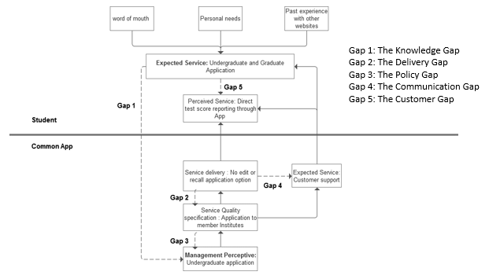
Gap Analysis Model

Slide 13
Product Improvements
Graduate Program Admission
Common app strictly for undergraduate programs
No centralized application process for graduate school
Account creation -> ‘Undergraduate/Graduate’ selection option
GRE’s & TOEFL’s instead of SAT’s
Reporting of scores by Testing Agencies only
Common App allows self-reporting
Leads to issues such as:
Users reporting false scores
Schools being untrusting of self-reported scores
Issue of coverage
Features certain schools in certain countries
Solution requires collaboration between Common App and those desired schools
Ultimately decided that issue is out of scope

Slide 14
Works Cited
www.commonapp.org
http://njit2.mrooms.net/pluginfile.php/899258/mod_resource/content/1/Alter-WSM-Systemns_Thinking_for_Bus_Profs-Jan-2011.pdf
http://njit2.mrooms.net/pluginfile.php/899257/mod_resource/content/1/Alter-Validating_Work_System_Principles-Jan-2010.pdf
Paul Harmon, Business Process Change: A Guide for Business Managers and BPM and Six Sigma Professionals, 2nd Edition, Morgan Kaufmann, 2007.

